Slide 1
NPC 09/15 – US ALGORITHM PLATFORM
(Systematic and rule based strategies embedded into Index format)
Equity Markets
09/10/2015
Business Management – New Product New Activity Committee

Slide 2
Table of contents
Presentation of the request
Request to launch a rule based indices product offer

Slide 3
1 - Presentation of the request
Sponsor:
Equity Markets US (Flow and Solution Trading - Sales and Financial Engineering)
Scope of products:
Main characterictics
The aim is to offer an innovative and bespoke investment solution. It will allows US, Canada and Latin America based investors to access systematic strategies (on multiasset types of portfolios) embedded in rule based indices. Investors may access to the rule based index through various investment wrapper included (but not limited to) total return swaps, OTC options, Natixis Notes (Reg S and 3(a)2).
Natixis wil be in charge of the index replication and in most cases will (i) publish a valuation of the rule based index (ii) provide periodically a performance analysis and /or comments on the index performance
This US Algorithm platform :
will cover a broad range of systematic strategies wrapped into indices including e.g. investment, hedging, market access, beta, alpha, risk controlled strategies
may offer strategies based on various asset classes, with an initial focus on Equity related types of underlying
will avoid any discretion in the strategy implementation thanks to the thorough transparency given through the index rules governing the strategies
Will include strategies designed both internally or with the help of a third party (e.g. Natixis Affiliates, Asset Management Companies, famous Index Sponsors)

Slide 4


Scope of the request
Natixis has already been offering investment products linked to rule based indices designed internally or externally.
Our understanding is that the above activity has already been formally approved in February 2010 in Europe by NPC 09-30
In practice non US based customers have already been offered some rule based index investment solutions and Natixis has been demonstrating some commercial successes on European based investors.
Natixis has already started working on potential rule based strategies that could fit for Americas based customers, including potential partnerships with external providers such as Wilshire, S&P and NGAM affiliates (AlphaSimplex and Gateway).
The existing Natixis offering on rule based indices is available on internal site SENSI:
http://sharecib.intranet/sites/equityderivatives/en/NXSIndices/Pages/NXS-Indices.aspx
Build a US algorithm index platform with the objective of covering mainly Latin Americas, Canada and US based customers
Customer target include (but not limited to) :
-Distribution: Private Banks
-Institutional investors : Asset management companies, Insurance companies, pensions funds and endowments
Investment wrappers include :
-TRS, OTC options, Notes
Investment products will be offered through private placements

Slide 5
Overview
What is Natixis US algorithm Platform ?
  A variety of systematic strategies embedded into rule based Indices
  Strategies include different investment styles or objectives
  Most strategies designed internally (Natixis as the Index sponsor )
  A few strategies sponsored by an external party
  Systematic strategies enable no room for discretion in the implementation
Why is it an interesting offer for US, Canada and Latin America based investors
  - Rule based indices offer full transparency and no discretion in implementation for investors
  - Rule based indices are offered inside simple payoffs / Indexations
  - Rule based indices offer innovative investment themes and profiles
  - Rule based indices offer flexibility of implementation inside various wrappers
Why is it interesting for Natixis in the Americas region ?
      There is a strong demand from customers (see above) Natixis is already late compared to the competition (other banks’ algorithm platforms are 5-10 years old)
      Natixis started already building internal expertise on both algorithm strategy generation and implementation / replication (eg outside the US)
      This new offer should help both the broadening of the customers’ range in the Americas region
      Natixis’ revenues should be better diversified and more stable

Slide 6
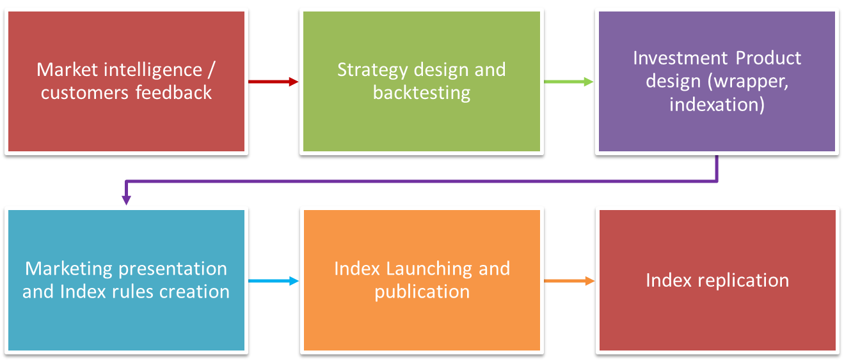
What is Natixis US algorithm Platform ?
Different steps of a rule based index creation

Slide 7
What is Natixis US algorithm Platform ?
  Risk Premia
  Smart Beta
  Multi Assets
  BuyWrite
  Investment Thematic
  Hedging
Examples of investment themes

Slide 8
What is Natixis US algorithm Platform ?
  NGAM Affiliate
  Standard and Poor’s
  Wilshire
Typical features of a partnership:
-Investment Strategy design by an external party
-Index branded in external party name and licensed to Natixis
-Natixis granted exclusivity regarding commercial distribution
-Natixis in charge of Index replication
Examples of potential partnerships with external parties

Slide 9
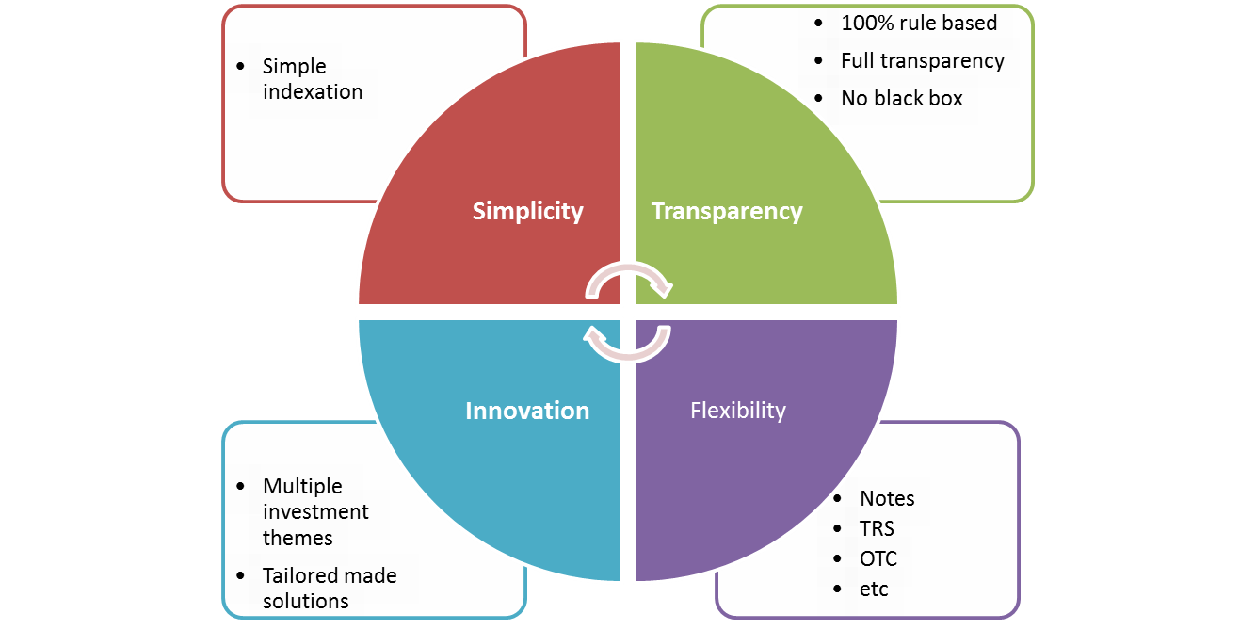
Why is it an interesting offer for US, Canada and Latin America based investors ?

Slide 10

Why is it interesting for Natixis in the Americas region ?

Slide 11
2 – Request to launch Rule based Indices product offer
Requests:
Equity Markets is asking NPC to approve an activity with the following features :
Customers : US, Canada and Latin America based
Customers type: Private banks, Institutional (insurance companies, foundations, endowments, etc…)
Wrapper: OTC options, TRS, Notes
Investment universe : Equities and Equity derivatives (listed options, futures, futures on Equity volatility and listed options on volatility) ETFs, Mutual Funds and Bonds
Private Placements only
Investment underlying: Rule based indices i.e. 100% transparent and systematic strategies with no discretion
Indices branded with Natixis name or an external party name selected by Natixis

Slide 12
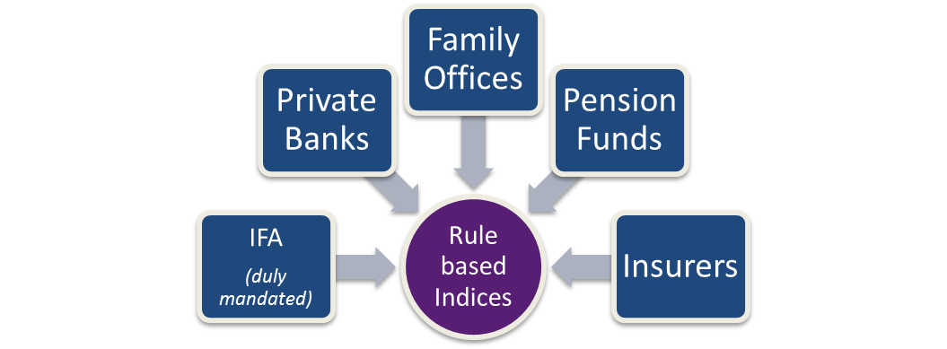
2-Clients target
Clients:
Rules based Indices can be invested by a diverse type of investors.
Geography:
US, Canada and Latin America based investors

Slide 13
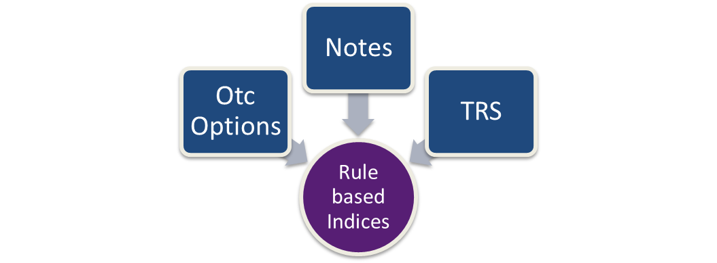
2-wrappers
wrappers:
Rules based Indices can be invested inside various warppers
Private Placements
Private placements only – both Reg S and 3(a)2 Notes will be concerned

Slide 14
2-Business expectations – Business validation
P&L estimated:
USA: €5M€ p.a. (for a aggregate nominal of 500M€ by 2018)
Canada: €2M€ p.a. (for a aggregate nominal of 200M€ by 2018)
Latin America: €1M€ p.a. (for a aggregate nominal of 100M€ by 2018)
Additional P&L :
1.5%-2% upfront on OTC options
Trading margin (in addition to P&L estimate): 50 bps to 1% running

Slide 15
2-Booking sections
-Index Backtesting:
Financial engineering: Strategy generation, scripting and backtesting
-Index Documentation:
Financial engineering, legal and trading: Index rules validation
legal: Pricing supplement generation (Notes Reg S or 3(a)2 )
-Index Publication calculation and Bloomberg Publication:
Trading desk Equity Finance : index calculation
SDR actuariat : Bloomberg publication
-Marketing:
Sales, Financial engineering and compliance: Marketing material validation
-Booking:
Trading: desk FAST NY for index derivatives replication
Trading: desk Equity Finance for index delta one replication
-Systems:
Caesar Indice and Sophis
-Target starting date:
Approval required by October 2015

Slide 16
Contacts
US ALGORITHM PLATFORM
Stephane Launay Tel: +1 212 891 1892 stephane.launay@us.natixis.com
Sam Rosenberg Tel: +1 212 891 5768 samuel.rosenberg@us.natixis.com
Aurelien Rabaey Tel: +33 1 58 55 8602 aurelien.rabaey@natixis.com
Fabrice Tenga Tel: +1 212 891 5744 fabrice.tenga@us.natixis.com

